Slide 1
Hospital Management System
Web Technology Mini Project
2019 Pattern
A.Y.2021-22
T.E. Semester -II

Slide 2
Contents
Team members detail
Objectives
Technical Details
Output Snapshot
Conclusion

Slide 3
Team member details
Sr. No | Roll No. | Name of the student
01 | TC03 | Adinath Mahangare
02 | TC33 | Niraj Shaha
03 | TC36 | Pratik Khetmalis
04 | TC47 | Rutik Lahamate

Slide 4
Objectives
No need for a physical attendant for every patient
Wherein it could be automated and handled with technology.
System will handle information such as patients with mild diagnoses and prescriptions.
Idea of having automated patient management is a big help for our health care workers
Securing various information of the patients.
To keep patient-doctor confidentiality as well as assure them of their healing factors.

Slide 5
Technical Details
Software Requirements:
VS Code
XAMPP Server
MySQL
Technologies Used:
HTML
CSS
PHP
SQL
AJAX

Slide 6
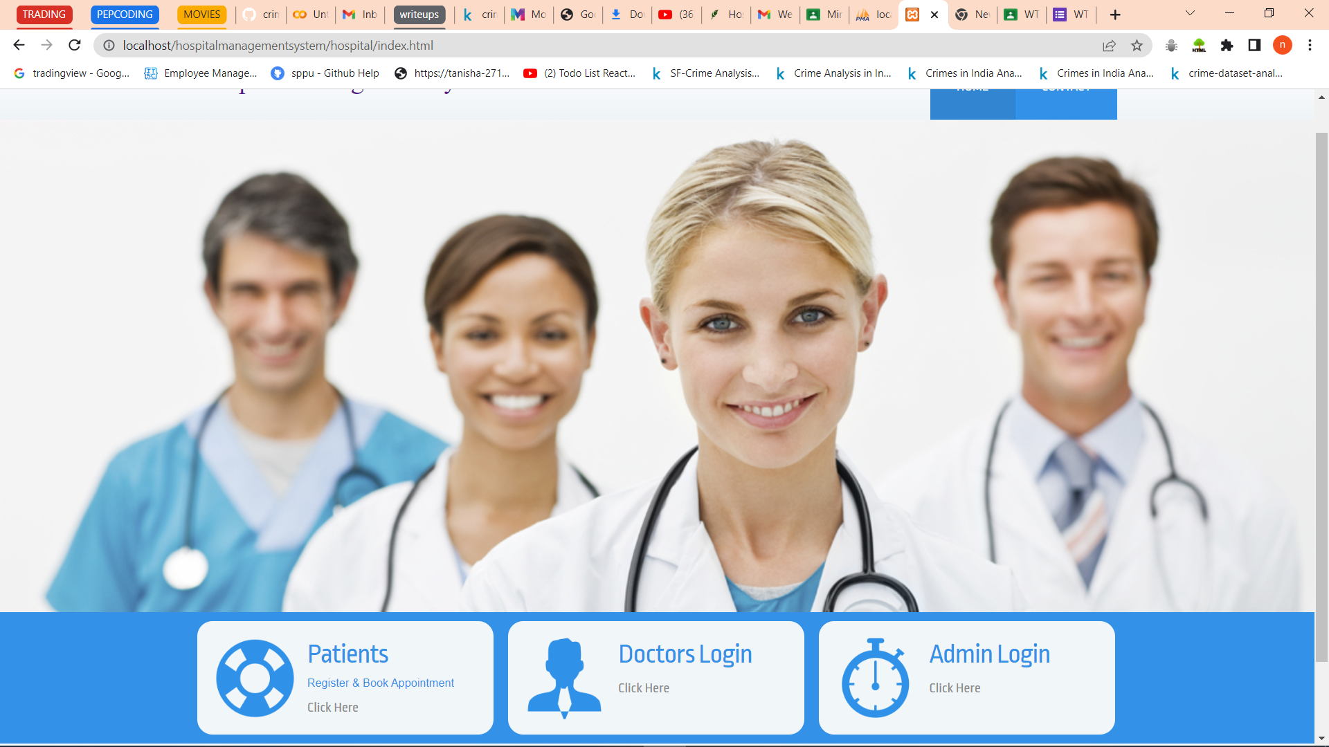
Output Snapshots
Fig 1.0: Home Page of the system

Slide 7
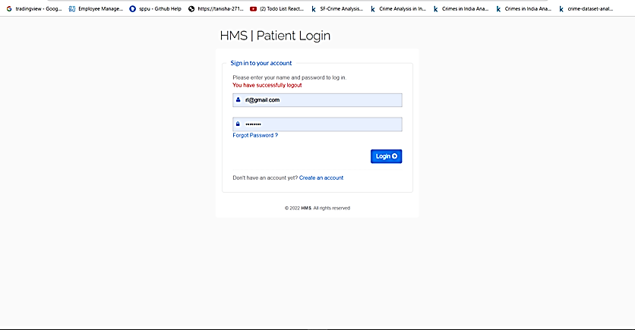
Output Snapshots
Fig 2.0: Patient’s login page

Slide 8
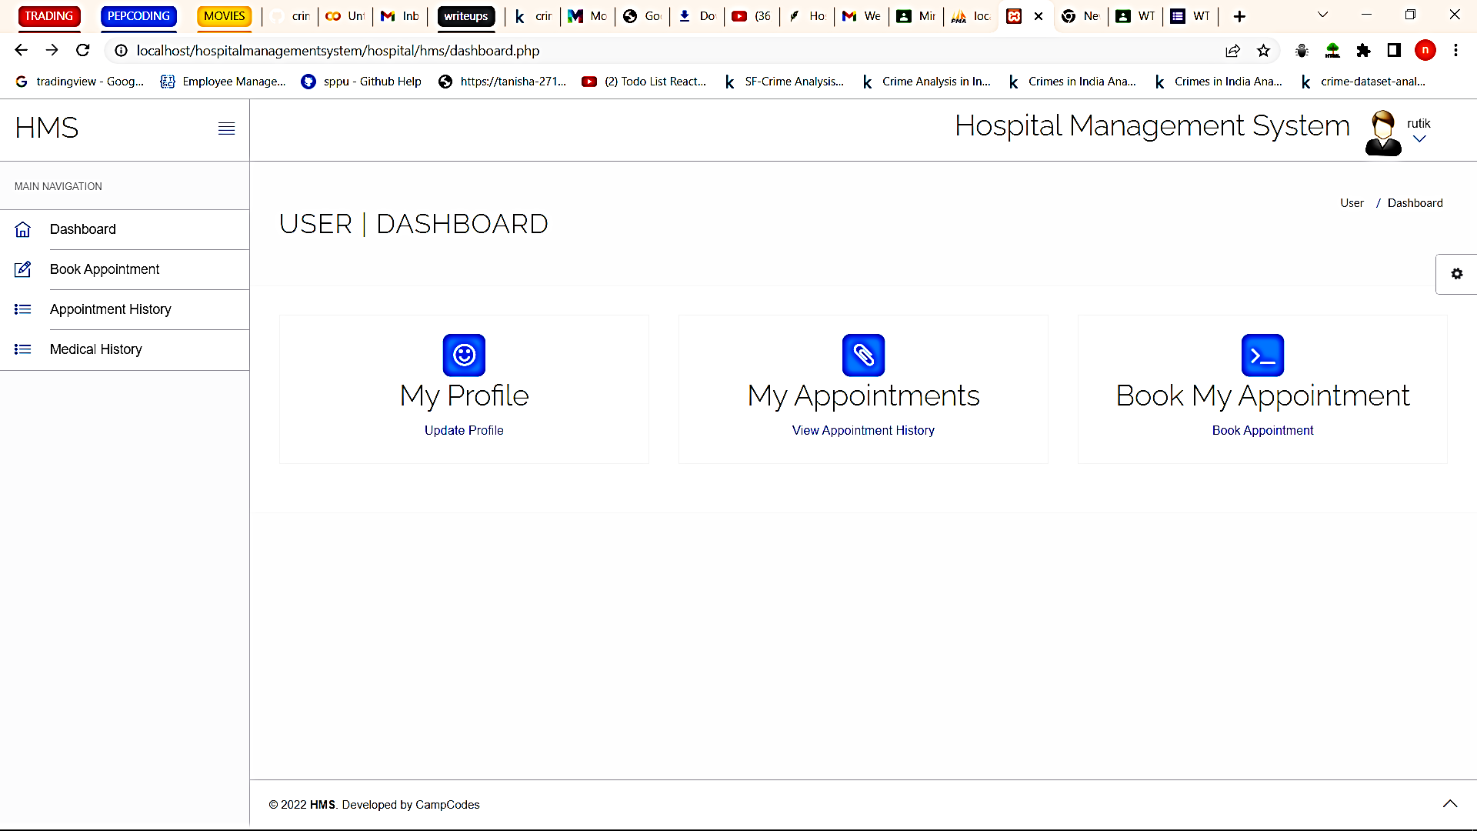
Output Snapshots
Fig 3.0: User Dashboard

Slide 9
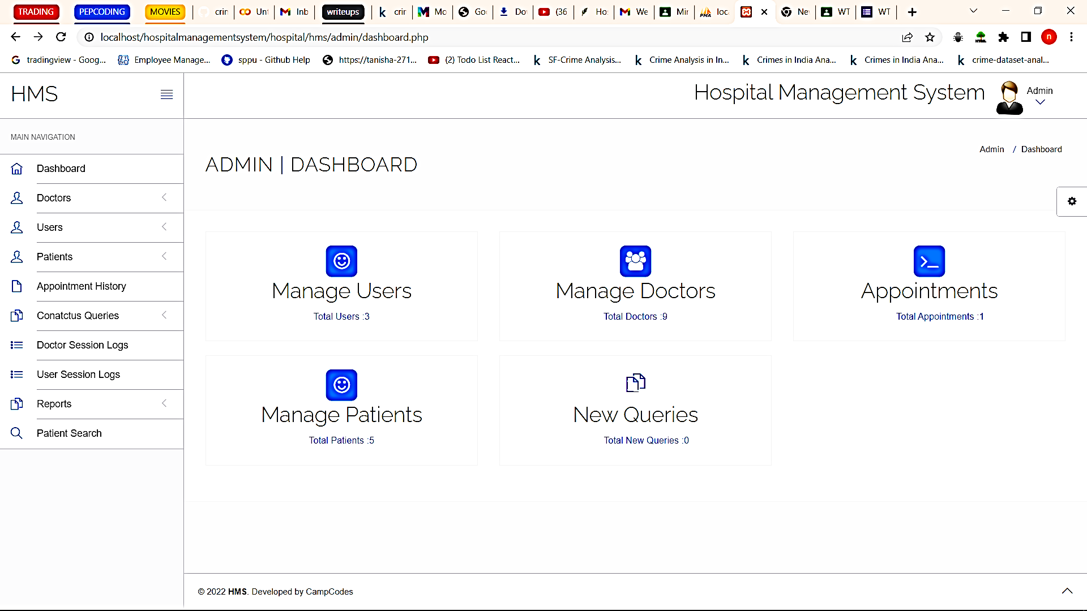
Output Snapshots
Fig 4.0: Admin Dashboard

Slide 10
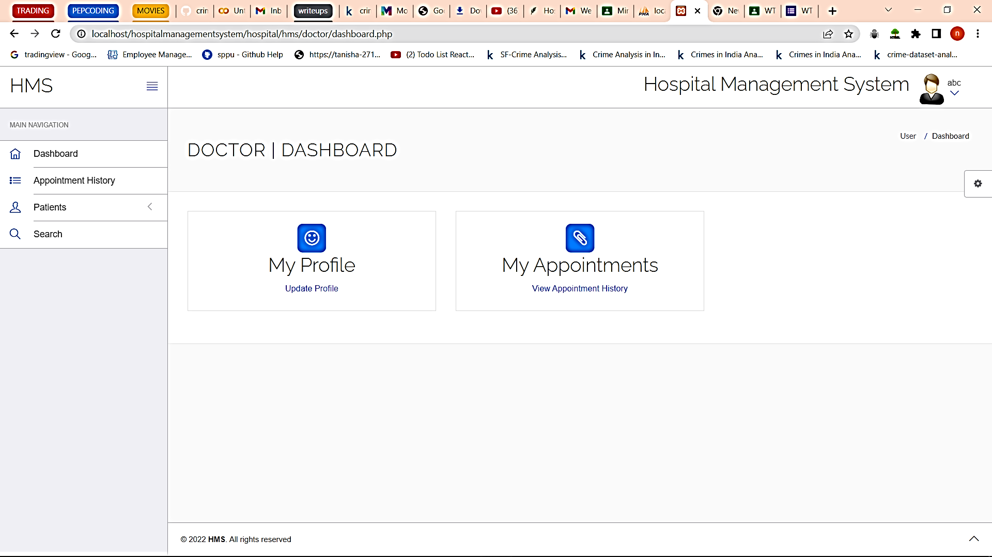
Output Snapshots
Fig 5.0: Doctor’s Dashboard

Slide 11
Conclusion
Automation improves the efficiency
friendly graphical user interface compared to the existing system.
appropriate access to the authorized users depending on their permissions.
It effectively overcomes the delay in communications.
Updating of information becomes so easier.

